Slide 1
Digital copyright and licenses
Mack 2021

Slide 2
Copyright, DRM, and the DMCA
The Internet is full of creative works: songs, artwork, books, t-shirt designs, videos, and more. The Internet makes it easy to enjoy and share those creative works, but that doesn't mean it's always legal to do so.
The majority of creative works are copyrighted, which means they are the intellectual property of the creator. Copyright gives the creator legal rights to determine whether their work can be copied and under what conditions.
Let's explore copyright laws, the doctrine of fair use, and the ways that copyright laws have adapted in the digital age.

Slide 3
Copyright laws
The first copyright law came about in England in the 1700s, prompted by the invention of the printing press and unregulated copying of books. Since then, most countries have introduced copyright law and 177 countries (including the United States) have agreed to the Berne Convention, an international agreement on copyright across borders.
In countries that support the Berne Convention, a creative work is copyrighted as soon as it is "fixed in a tangible medium" (for example, written down in a physical or digital medium). The author is entitled to the copyrights of that work and does not need to post copyright notices. Authors are not required to formally register their work, but they may choose to register so that they can enforce the copyright in court.

Slide 4
Copyright laws
Authors don't, however, have exclusive rights to their ideas; only rights to the way the ideas are expressed.
What rights does that give the author? In the United States, these are some of the exclusive rights:
The right to reproduce their work
The right to create derivative works
The right to distribute copies by sale or rental
The right to publicly display visual works
The right to publicly perform audio works via digital transmission
The copyrights don't last forever, however. The Berne Convention states a minimum duration of 50 years after the author's death, but the United States extended that to 70 years in most cases.
Once the copyright has expired, creative works enter the public domain, and can be used and adapted by anyone without restriction. Many famous books from the 19th century are now in the public domain, such as Bram Stoker's Dracula and Jane Austen's Pride and Prejudice.

Slide 5
Fair use
Copyright sounds fairly restrictive, yet we encounter uses of copyrighted works every day:
An album review in a magazine that quotes lyrics from a song
A classroom assignment that includes paragraphs from the class textbook
Search results that include thumbnails of images from the website
Are these copyright violations? Maybe—but in the United States at least, they might be legal according to the doctrine of fair use. Fair use allows limited use of copyrighted materials for purposes like criticism, comment, news reporting, teaching, or research.

Slide 6
Fair use
Ultimately, only a judge can determine if a particular use is fair use, and the judge will consider four factors:
What's the purpose and character of the use? (e.g. educational vs. entertainment, non-profit vs. for-profit, transformative vs. iterative)
What's the nature of the copyrighted work? (e.g factual vs. fictional)
How much of the copyrighted work is used, and how significant is that portion of the copyrighted work?
What's the impact of the use on the potential market for and value of the copyrighted work?

Slide 7
Fair use
If a non-profit educational website uses a paragraph from a history book in an article, it is likely to be considered fair use. If a commercial entertainment website streams an entire historical drama from a film studio, it is almost certainly not fair use.
The question of fair use does not always have a clear answer, so court cases help to expand on and specify the four factors, particularly what it means for a use to be "transformative." You can get a feel for what the courts deem to be fair use by looking through these past court cases.
🤔 What examples of fair use have you encountered? Have any of your own uses of copyrighted material met the criteria of fair use? How "fair" is fair use to the author of the work? [Discuss]
Notes:
🍐 This is a Pear Deck Text Slide
🍐 To edit the type of question, go back to the "Ask Students a Question" in the Pear Deck sidebar.

Slide 8
Copyright in the digital age
Back in the days of the printing press, few people had the ability to easily reproduce work, so copyright concerns weren't commonplace. But in the digital age, all of us can reproduce work. In fact, it's now so easy to violate copyright that many people violate copyright without even realizing it, simply by downloading a file, pasting some text, or sharing a funny image on social media.

Slide 9
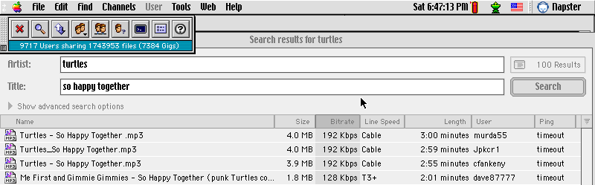
The rise of digital file sharing
In the 1990s, peer-to-peer file sharing networks emerged that made it very easy to download files. One of these networks, called Napster, was particularly popular—at its peak, some colleges estimated that 60% of their Internet bandwidth was being used by Napster to download MP3 files. Many of those MP3 files were digital recordings of copyrighted music; Internet users were happy to finally have a way to listen to hundreds of their favorite songs for free.

Slide 10
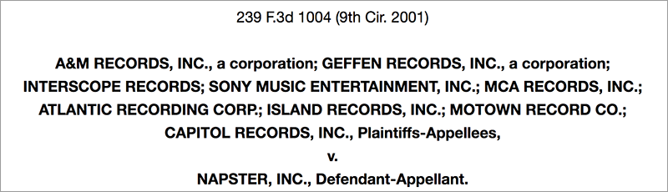
The rise of digital file sharing
However, recording artists discovered their songs circulating on Napster and they weren't all thrilled by the discovery. In 2001, Napster was suddenly facing three lawsuits for enabling copyright violations: one from heavy metal band Metallica, one from rapper Dr. Dre, and one from the top record companies in the music industry.

Slide 11
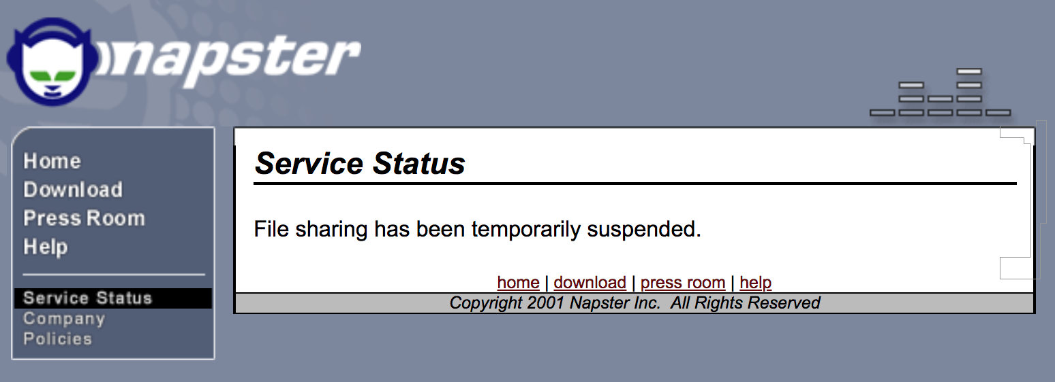
The rise of digital file sharing
As a result of those cases, Napster attempted to remove the plaintiff's copyrighted songs from search results using digital fingerprinting algorithms. When a judge ruled that it wasn't removing enough of them, Napster eventually shut down and filed for bankruptcy.

Slide 12
A new era in digital music
Thanks to the rise and fall of Napster, entrepreneurs realized that people wanted an easy way to listen to music online and have been experimenting with legal ways to make that happen ever since.
For example, the companies Spotify and Pandora offer monthly subscription services for streaming songs, while Amazon and Apple charge low prices to buy a single song. Generally, those companies pay royalties to the copyright owners of the songs and only offer songs by permission of the copyright owner.

Slide 13
Digital rights management
Even when a company gives customers an easy way to legally download a copy of copyrighted work, there is still a risk for future copyright violations. What if one customer decides to share it for free with thousands of others? The thousands will be happy, but the copyright owner won't get any revenue from their enjoyment of the work.
That's why some copyright owners are a fan of digital rights management (DRM): tools that restrict where and how a user can use copyrighted media.

Slide 14
Digital rights management
For example, the popular music streaming service Spotify adds a DRM layer to streamed songs which prevents their subscribers from listening to the songs anywhere besides Spotify apps. The DRM layer scrambles the audio data in a way that only the Spotify player understands how to unscramble. A desktop MP3 player would be confused by the audio data and not know how to play it.
Computer programmers like a challenge, however, and they've figured out ways to circumvent most forms of DRM. If a user really wants access to the original DRM-free data, they can often find tutorials and tools to circumvent the DRM. So if that's the case, what's stopping users from bypassing the DRM?

Slide 15
The Digital Millennium Copyright Act
In 1998, the United States passed the Digital Millennium Copyright Act (DMCA) which criminalizes the production and distribution of technology that tries to circumvent DRM.
Using the DMCA, a copyright owner can send takedown notices to services or individuals that are distributing their copyrighted works, and assuming their copyright has indeed been violated, the service or individual must comply with the takedown request or face legal action.

Slide 16
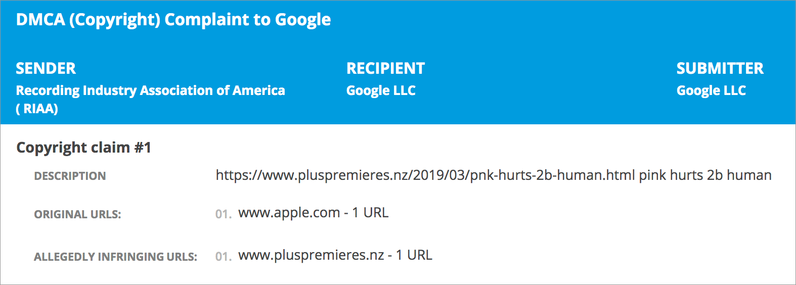
The Digital Millennium Copyright Act
Google has received over 4 billion DMCA takedown requests from copyright owners that discover their works show up in an unauthorized form in search results.
Here's one takedown request from the RIAA for a song by P!nk, a recording artist represented by their labels:

Slide 17
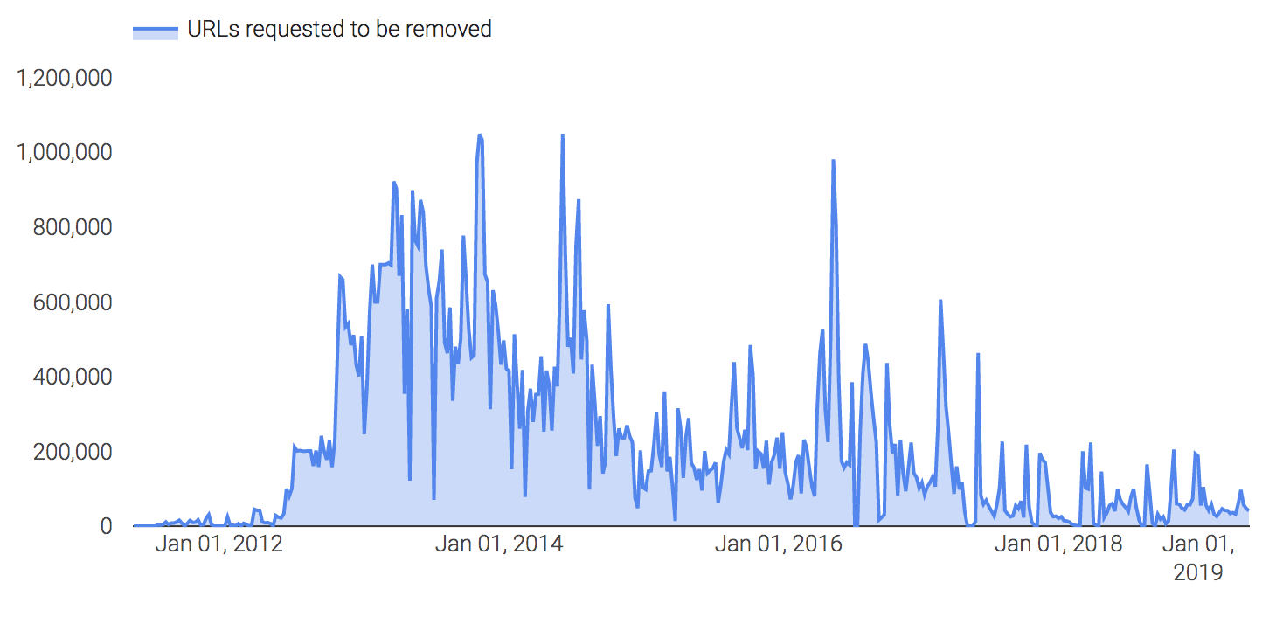
The RIAA alone sends Google thousands of takedown requests each day, as you can see in this chart:

Slide 18
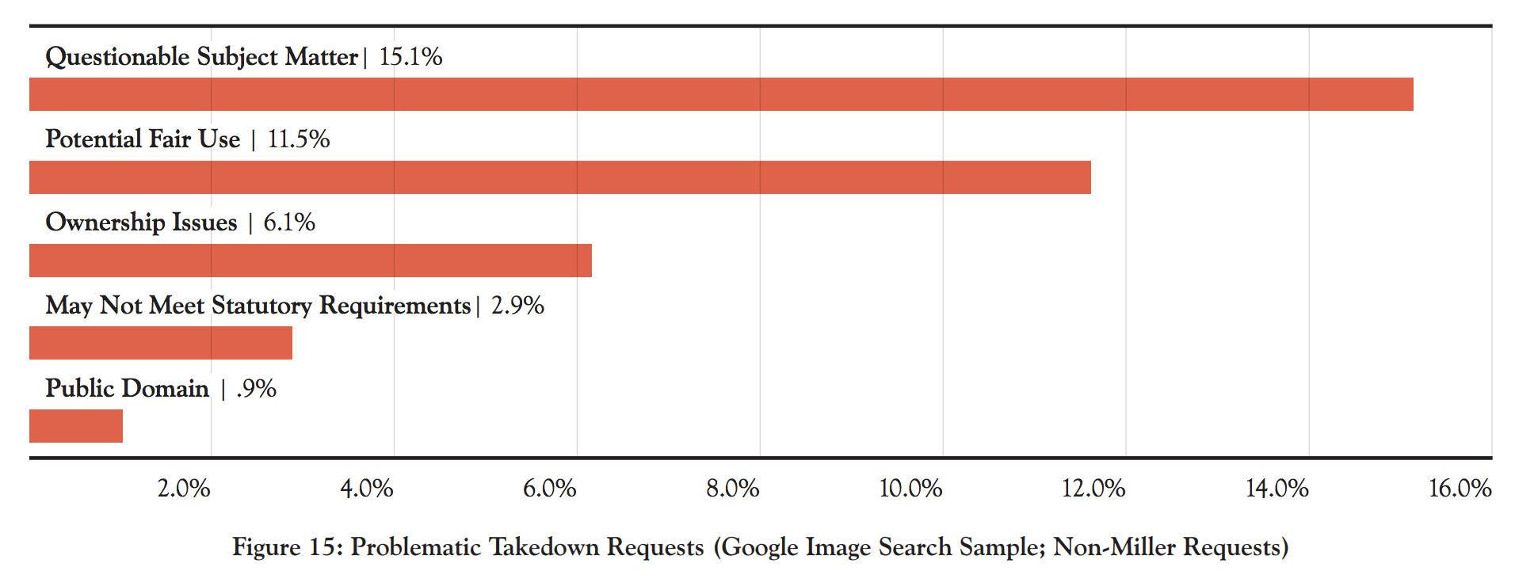
Concerns and criticisms
A common criticism of the DMCA is the abuse of takedown notices. In a 2016 study, researchers evaluated a random sample of DMCA takedown requests to Google Image Search, and found that about 36% were of questionable validity. As the chart below shows, nearly half of those invalid requests weren't actually copyright related complaints, and around one third were situations that were likely legal due to fair use:

Slide 19
Concerns and criticisms
Given the high proportion of invalid DMCA requests, most content hosting services use a combination of automated algorithms and human review to determine which notices are valid. However, services still make mistakes and accidentally take down legitimate content. While there are consequences for knowingly filing false takedown notices, some companies and individuals have used takedown notices for censorship or to stifle competition.
Another big concern about DRM and DMCA is the impact on visually impaired users who need to use assistive technologies like screen readers to consume digital media.

Slide 20
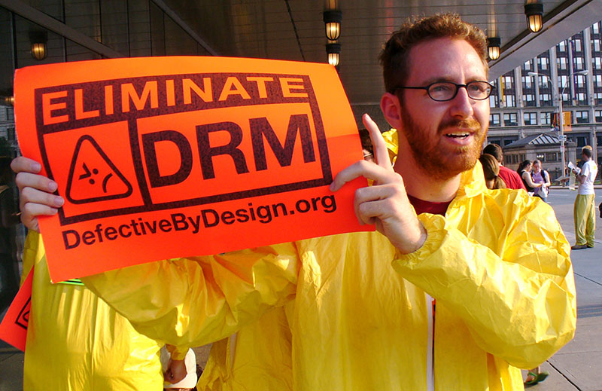
Concerns and criticisms
If an e-book is protected with DRM, a screen reader may be unable to read it entirely. This means the visually impaired user is either cut off from the information entirely or they must use a DRM circumvention technology and risk violating the DMCA. Neither of those are good situations, so there are movements to move away from DRM and exempt accessibility technologies from the DMCA anti-circumvention provisions.

Slide 21
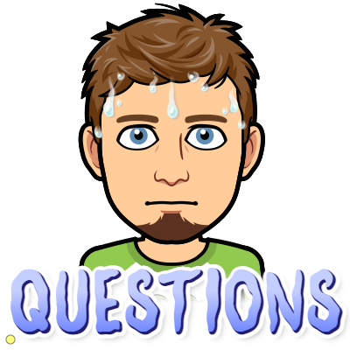
Notes:
🍐 This is a Pear Deck Text Slide
🍐 To edit the type of question, go back to the "Ask Students a Question" in the Pear Deck sidebar.

Slide 22
Creative commons and open source
In the U.S., as soon as you make a creative work and fix it in a tangible form, you are now the copyright owner and nobody else can distribute or adapt that work without your permission (except in the case of fair use).
But what if you want your work to be widely distributed and built upon?
Copyright owners can apply licenses to their creative works that lessen the copyright restrictions and increase what others are allowed to do with their works. Since licenses are legal documents written in legal-ese, it can be hard for a lay-person to read a license and fully understand its permissions.
Fortunately, the vast majority of copyright owners of now use a small set of popular and well understood licenses. For creative works such as writing and multimedia, copyright owners can apply one of the Creative Commons licenses. For software, programmers can apply an open source license. Any type of creative work can be made available in the public domain.

Slide 23
Creative Commons
Creative Commons is a non-profit organization that offers 6 licenses for sharing creative work.
All of the licenses require attribution, to make sure the original author is credited for their work.
The licenses differ in whether they also require these conditions:
Share Alike: The reused work must be licensed using the same CC license as the original work.
Non-Commercial: The reused work can only be used for non-commercial purposes.
No Derivatives: The original work can be distributed and displayed, but it cannot be modified.

Slide 24
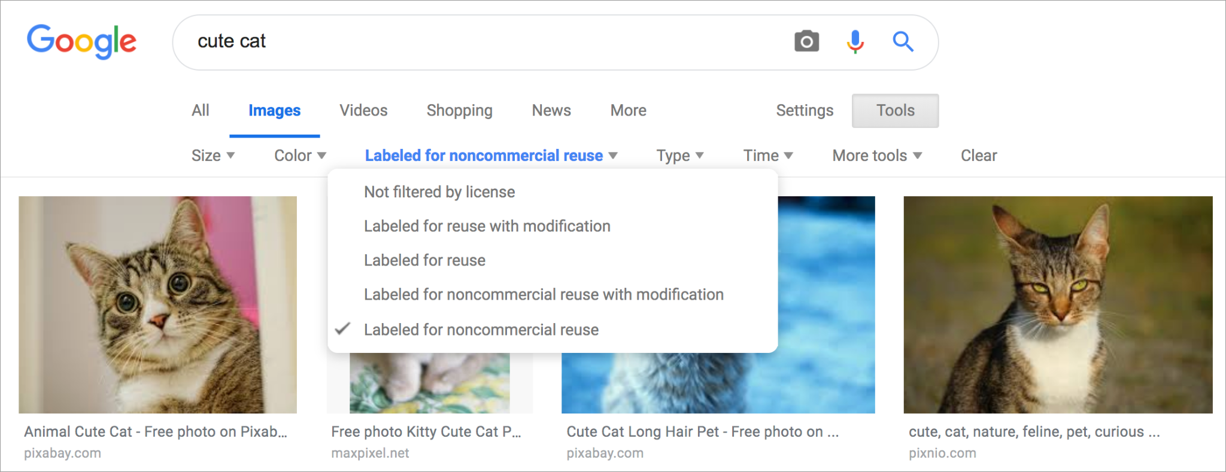
Using CC-licensed content
According to the State of the Commons in 2017, there were more than 1.4 billion CC-licensed works available online, a mix of images, videos, sound recordings, presentations, articles, and more.
To sort through all that CC-licensed material, try using Creative Commons search or Google Image Search, with results filtered based on license.

Slide 25
Using CC-licensed content
Generally, if a creative work is available under a CC license, the license will be written near the work somewhere. It might be in an image caption or a video description, or it may even be in the footer of a website, if all of the content on the site is under the same CC license.
Remember that when a content creator makes their work available under a CC license, they still have rights. As users and remixers of CC-licensed content, we have a legal obligation to respect the conditions of the license: to always provide attribution, and to only use the work if our remix satisfies all the conditions.

Slide 26
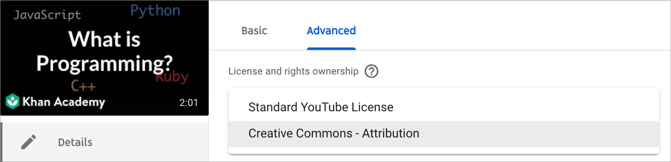
Making CC-licensed content
To host CC-licensed creative work on your own website, you can use the Creative Commons tool to choose a license and display it visibly near the work. If you use a content hosting site like YouTube or Flickr, they often provide a way for creators to specify a CC license for uploaded work.

Slide 27
Open source
Computer software is often a lot more alike than it is different. Just consider the apps you use every day; they have user interfaces with buttons, forms, and menus, they authenticate user logins in the server code, and they store data in databases.
If software engineers had to write all of that code from scratch every time they built a new app, there would be a lot fewer websites and apps in the world. Instead, many software engineers build on the work of others, thanks to the growing availability of open source code.

Slide 28
Open source licenses
When a programmer wants to make their code reusable, they publish it online under an open source license. That license enables other programmers to bring the code into their own projects, as long as their reuse meets the conditions of the license.
An example of a broad and permissive open source license is the MIT license. It allows for distribution, modification, commercial use, and private use of the code, as long as the copyright and license information are included in the reused code.

Slide 29
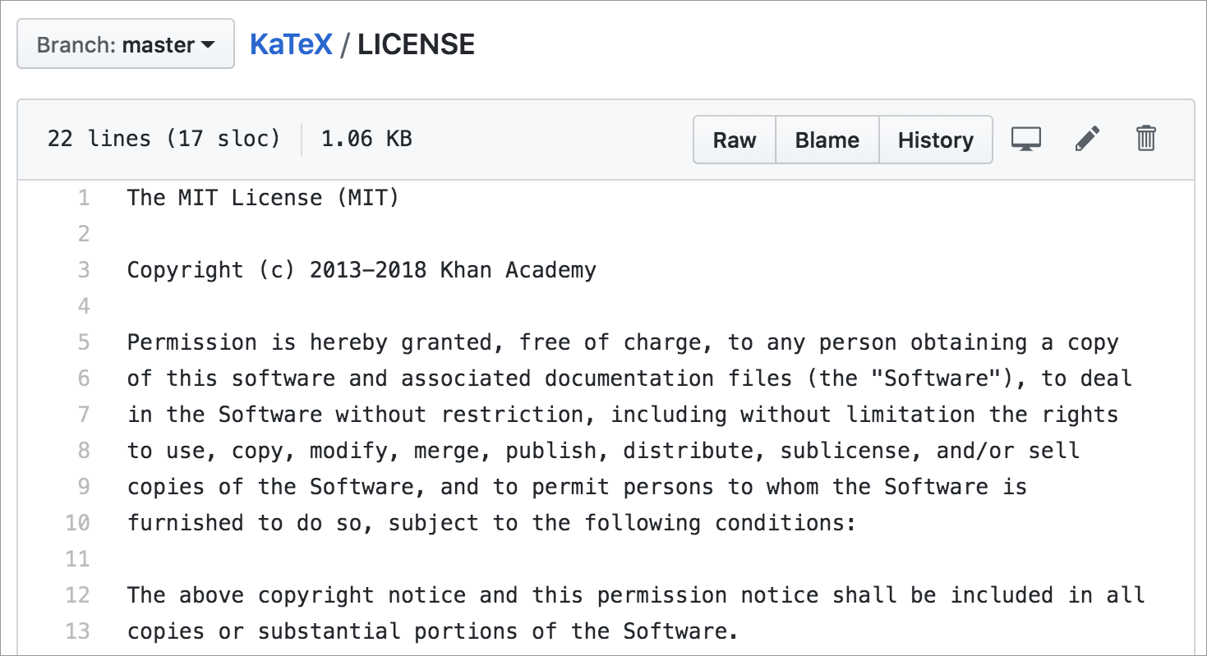
Open source licenses
Here's the MIT license file for KaTeX, a JavaScript library that renders math equations:

Slide 30
Open source licenses
There are a number of other open source licenses that software companies and programmers can attach to their codebases, and the most popular licenses are tracked by the Open Source Initiative.
Some open source licenses are "copyleft", a similar restriction as the "share alike" condition for Creative Commons licenses. When you use open source software with a copyleft license, your derivative software typically must be distributed with a copyleft license as well.

Slide 31
Using open-source code
There are many benefits to using open source software in a codebase:
Software engineers no longer need to write the code that's available from the open-source project and can spend their time writing code that's specific to their product.
There are often multiple open source projects with similar goals, such as the hundreds of drag-and-drop JavaScript libraries that are available online. A software engineer can quickly try out libraries and choose the best one for their needs, without having to pay money or negotiate permission.
Popular open source projects have multiple contributors, so their maintenance and improvement does not depend on a sole engineer or a particular company. About 15,600 developers from more than 1,400 companies contributed to the open-source Linux operating system from 2005-2017.

Slide 32
Using open-source code
There are also drawbacks, with security being one of the biggest concerns. Since anyone can look at open source code, a hacker could find a vulnerability in the code and then use their knowledge of that vulnerability to carry out cyber attacks. Even worse, they could submit a code change to an open source codebase that introduces a new vulnerability.
In July 2018, an attacker introduced code into a popular JavaScript tool that stole authentication credentials for thousands of users. A few months after, another attacker introduced code into a JS library that harvested account details from users of a cryptocurrency wallet app.

Slide 33
Making code open-source
Before any business or engineer can even consider using open source software, someone out there needs to actually make their code open source.
What are the benefits of making your own code open source? On a personal level, it can feel very good for a software engineer to give back to the software ecosystem. For a business, there's a potential of attracting a community of open source contributors that can improve the code more than the business can with their own resources.

Slide 34
Making code open-source
But of course, there are always drawbacks to consider. When you make code open source, you're inviting many more developers to use and rely on that code. Those developers will have questions, suggestions, and bug reports, and it takes significant time to respond to the community.
If you're a business that's considering making your code open source, then you also need to consider the competition. Could someone come along, take your code, and put you out of business? Many companies do successfully make money off an open source product, but they typically also offer other services like support and consultation.
🤔 If you were starting a technology company, would you make your code open source? Why or why not? [Discuss]
Notes:
🍐 This is a Pear Deck Text Slide
🍐 To edit the type of question, go back to the "Ask Students a Question" in the Pear Deck sidebar.

Slide 35

Public domain
A creative work that is in the public domain is no longer protected by copyright law and free of copyright restrictions. Anybody can use and reuse that creative work in any way, and they do not have to provide attribution.
Creative works with expired copyrights automatically enter the public domain, decades after the creator's death. The works of Shakespeare, the compositions of Mozart, and the paintings of Rembrandt are all now in the public domain.

Slide 36

Public domain
While a creator is still alive, they can choose to waive their exclusive rights voluntarily by declaring that their work is in the public domain. Creative Commons suggests using the CC0 license to declare such a waiver in a way that works across countries with different copyright laws.

Slide 37
Notes:
🍐 This is a Pear Deck Text Slide
🍐 To edit the type of question, go back to the "Ask Students a Question" in the Pear Deck sidebar.

Slide 38
Practice

Slide 39
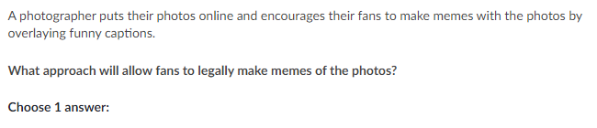
Notes:
🍐 This is a Pear Deck Multiple Choice Slide. Your current options are: A: The photographer should write "This work is licensed under a Creative Commons Attribution license.", B: The photographer should write "This work is licensed under a Creative Commons Attribution No Derivatives license.", C: The photographer should link to an open source license (like the MIT license) from the gallery page., D: The photographer should write "Copyright © 2019 Todd's Takes" under each of their photos.,
🍐 To edit the type of question or choices, go back to the "Ask Students a Question" in the Pear Deck sidebar.
A

Slide 40
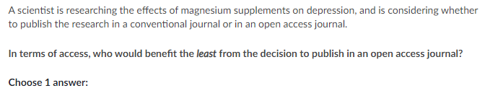
Notes:
🍐 This is a Pear Deck Multiple Choice Slide. Your current options are: A: A high school mental health counselor, B: A layperson with a history of depression, C: A researcher at a top-tier university, D: A doctor in a developing country,
🍐 To edit the type of question or choices, go back to the "Ask Students a Question" in the Pear Deck sidebar.
C

Slide 41
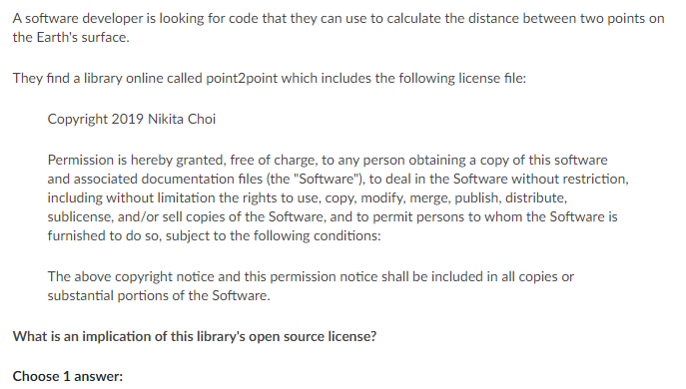
Notes:
🍐 This is a Pear Deck Multiple Choice Slide. Your current options are: A: The software engineer can use the code, but only if they use it in software that is also licensed under the same open source license., B: The point2point library code is no longer subject to copyright law and is free from copyright restrictions., C: The point2point code can be included in any other codebase, and no attribution is required., D: The software engineer is legally allowed to use the code in a software application that they sell to customers.,
🍐 To edit the type of question or choices, go back to the "Ask Students a Question" in the Pear Deck sidebar.
D

Slide 42
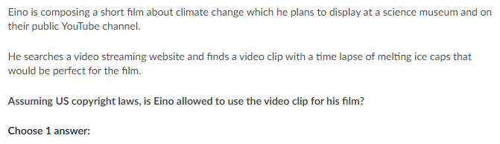
Notes:
🍐 This is a Pear Deck Multiple Choice Slide. Your current options are: A: He can only use the video clip if it has been explicitly stated to be in the public domain; he can't use it if it's licensed any other way., B: He can use the video clip if it is explicitly licensed for re-use, like with a Creative Commons license, and he follows the conditions of that license., C: If there is no explicit license declared next to the video clip, then the clip is in the public domain and can be used freely for any purpose., D: He can use the video clip as long as he provides attribution, such as an author name and link back to the streaming site.,
🍐 To edit the type of question or choices, go back to the "Ask Students a Question" in the Pear Deck sidebar.
B

